Slide 1


GROUP C PRESENTATION
DICTIONARY
ATTACKS
NAME | REG_NO | STUDENT NUMBER
BUGEMBE JOHN PAUL | 2024/HD05/26501U | 2400726501
AMPEIRE EDGAR | 2024/HD05/21915U | 2400721915

Slide 2
What to cover…
What is a dictionary attack?
How do dictionary attacks work?
Why are dictionary attacks effective?
Mitigation Techniques.
Conclusion

Slide 3

WHAT IS A DICTIONARY ATTACK
A dictionary attack is a method used to breach password security by systematically entering every word in a predefined list, or "dictionary," in an attempt to guess a user's password.

Slide 4

HOW DO DICTIONARY ATTACKS WORK?
1. Predefined Wordlist:
Attackers use a list of potential passwords, often containing
common words, phrases, and patterns known to be frequently used by individuals. This list may include words from various dictionaries, commonly used passwords, or data
from previous security breaches.

Slide 5
HOW DO DICTIONARY ATTACKS WORK?
2. Automated Tools
Software tools are employed to automate the attack, quickly inputting each word from the dictionary into the password field of the target system. This process continues until the correct password is found or the list is exhausted.

Slide 6
HOW DO DICTIONARY ATTACKS WORK?
3. Success Based on Simplicity
The success of a dictionary attack hinges on the simplicity
and predictability of user passwords. If a user's password is a common word or phrase found in the dictionary, the attack is likely to succeed.

Slide 7
Why Dictionary Attacks Are Effective?
User Behavior
Speed and Efficiency
Availability of Data

Slide 8


Mitigation Techniques
Strong Password Policies
Enforce the use of complex passwords that include a combination of uppercase and lowercase letters, numbers, and special characters.
Require a minimum password length, typically at least 8-12 characters, to increase the complexity and reduce the likelihood of the password being in a dictionary.
Avoid simple, easily guessable passwords and encourage the use of unique passwords for different accounts.

Slide 9
Mitigation Techniques
Strong Password Policies
Enforce the use of complex passwords that include a combination of uppercase and lowercase letters, numbers, and special characters.
Require a minimum password length, typically at least 8-12 characters, to increase the complexity and reduce the likelihood of the password being in a dictionary.
Avoid simple, easily guessable passwords and encourage the use of unique passwords for different accounts.

Slide 10
Mitigation Techniques
Account Lockout Policies
Implement an account lockout mechanism that temporarily disables an account after a set number of consecutive failed login attempts. This limits the number of guesses an attacker can make in a short period.
Use progressive delay mechanisms to increase the wait time after each failed login attempt, further deterring attackers.

Slide 11
Mitigation Techniques
Multifactor Authentication (MFA)
Require an additional form of verification beyond just a password, such as a code sent to a mobile device, a hardware token, or biometric authentication.
MFA adds a significant layer of security, making it much harder for attackers to gain unauthorized access even if they obtain the password.

Slide 12
Mitigation Techniques
User Education
Educate users about the risks of using simple passwords and the importance of creating strong, unique passwords for each account.
Encourage the use of password managers to generate and store complex passwords securely.

Slide 13
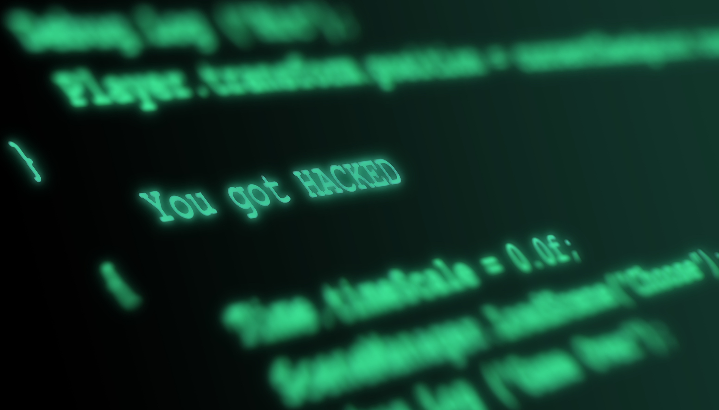
CONCLUSION
Dictionary attacks pose a significant threat to access control systems by exploiting weak, predictable passwords.
However the mitigation techniques as discussed, organizations can strengthen their access control defenses and protect against unauthorized access.

Slide 14
THE END
THANK YOU

